Slide 1
Intrusion Detection and Prevention Systems
Firewall Basics
Dr. P. Raghu Vamsi, JIIT University, Noida

Slide 2
Intrusion Detection and Prevention Systems
Also a you may view the lecture videos via my YouTube Channel at
https://www.youtube.com/channel/UC0oJO4o-UeMt5irLm6kxIWA
Dr. P. Raghu Vamsi, JIIT University, Noida

Slide 3
An Overview of Firewalls
Firewall
Hardware or software configured to block unauthorized network access
Firewalls cannot protect against malicious insiders
Send proprietary information out of the organization or copy confidential information to disk
Firewalls cannot protect connections that do not go through it
Such as remote dial-up connections

Slide 4
An Overview of Firewalls
Any network firewall is a combination of multiple software and hardware components
Term firewall perimeter might be more descriptive
Earliest firewalls were packet filters
Single packet-filtering router was placed at perimeter
Some firewalls are designed for consumers
Norton Security Suite Firewall
ZoneAlarm

Slide 5
Overview of Firewalls
With personal firewalls:
Establishing rules for blocking traffic are done case-by-case
Prompts whether traffic should be allowed or not
Check Point NGX firewall
Example of a firewall designed to protect and monitor large-scale networks
Firewall appliances
Self-contained hardware devices added to a network
Cisco PIX is an example

Slide 6
Overview of Firewalls
Firewalls are not a standalone solution
Cannot protect from internal threats
Need strong security policy and employee education
Policy should include strict procedures for keeping patches updated and checking for vulnerabilities
Firewalls must be combined with
Antivirus software
IDPS
Defense in depth (DiD): layered defense strategy that includes an IDPS, firewalls, antivirus software, access control and auditing

Slide 7
Comparing Software and Hardware Firewalls
Core functions of firewalls:
Filtering
Proxying
Logging
This chapter covers the two main types of firewalls:
Software-based firewalls
Hardware-based firewalls

Slide 8
Software-Based Firewalls
Software programs can be combined with hardware devices to create a secure checkpoint
Require extensive configuration
Free firewall programs
Logging capabilities are not as robust as some commercial products
Configuration can be difficult
Popular free firewall programs
Netfilter
ZoneAlarm

Slide 9
Software-Based Firewalls
Commercial Firewall Programs: Personal firewalls
Located between the Ethernet adapter driver and the TCP/IP stack
Inspect traffic going between the driver and the stack
Popular choices
CA Internet Security Suite
Norton Internet Security
ZoneAlarm Internet Security Suite
Kaspersky Internet Security
Do not offer extensive firewall protection

Slide 10
Software-Based Firewalls
Commercial firewall programs: Enterprise firewalls
Include centralized management option
Some are capable of installing multiple instances from a centralized location
Some examples include
Check Point NGX
Proventia security products
Some products offer user authentication, NAT, encryption, and centralized management

Slide 11
Hardware Firewalls
Advantages
Do not depend on conventional OSs
Generally more scalable than software firewalls
Can handle more data with faster throughput
Disadvantages
They do depend on nonconventional OSs
Tend to be more expensive than software products

Slide 12
Hardware Firewalls
Hardware firewall examples:
Cisco ASA series
Fortinet FortiGate series
Barracuda NG Firewall

Slide 13
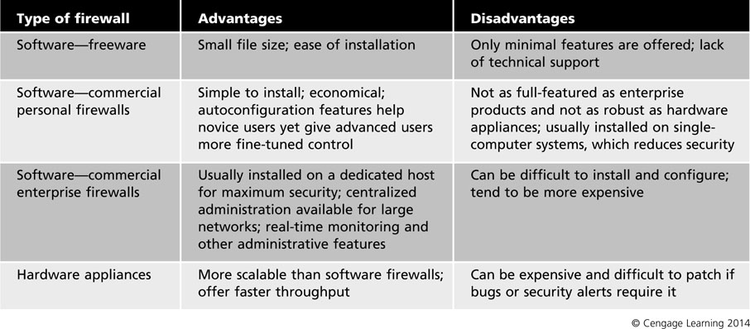
Table 1 Firewall advantages and disadvantages

Slide 14
Packet Filtering and Firewall Rule Sets
Stateless packet filtering
Stateful packet filtering
Packet filtering depends on position of components

Slide 15
Stateless Packet Filtering
Determines whether to allow or block packets based on information in the protocol headers
Filtering based on common IP header features
IP address
Ports
TCP flags
Intruders can get around these defenses
Advantage: Inexpensive
Disadvantages: Hard to maintain, vulnerable to IP spoofing, and no form of authentication

Slide 16
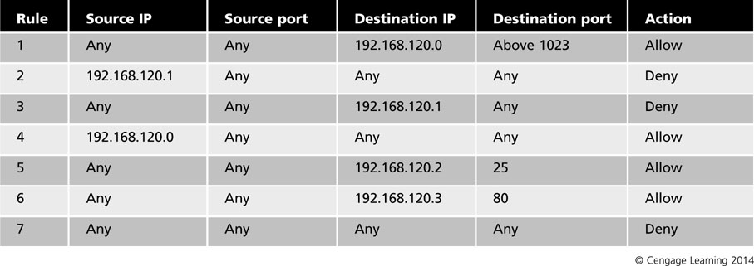
Table 2 Stateless packet-filtering rules

Slide 17
Stateful Packet Filtering
Keeps a record of connections a host computer has made with other computers
Maintain a file called a state table containing record of all current connections
Allows incoming packets to pass through only from external hosts already connected

Slide 18
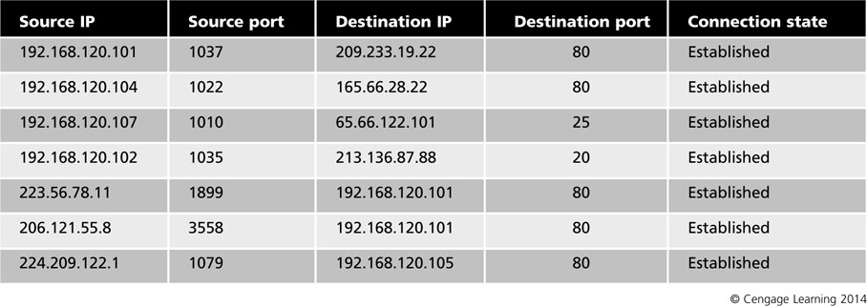
Table 3 State table example

Slide 19
Stateful Packet Filtering
Windows Firewall
One of the most user-friendly packet filters
Can limit the type of program traffic with more precision
Can even specify exceptions
Advanced tab allows more complex settings
Can create very specific rules to allow or deny packets based on protocols, ports, IP addresses, and other items

Slide 20
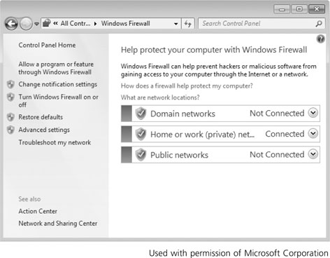
Figure 3 Windows Firewall

Slide 21
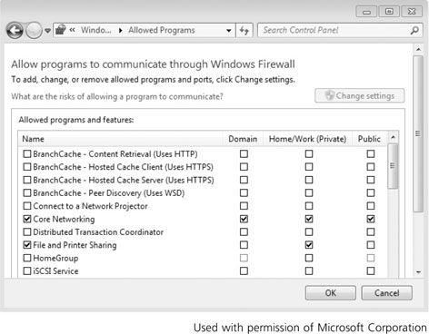
Figure 4 Programs allowed in Windows Firewall

Slide 22
Packet Filtering Based on Position
Type of filtering a device can do depends on
Position of the device in the firewall perimeter
Other hardware or software
Packet filter placement
Between the Internet and a host
All inbound and outbound traffic should be accounted for in the packet filter’s rule base
Between a proxy server and the Internet
Proxy server: handles traffic on behalf of computer on the network it protects
Rebuilds requests to hide internal IP address information

Slide 23
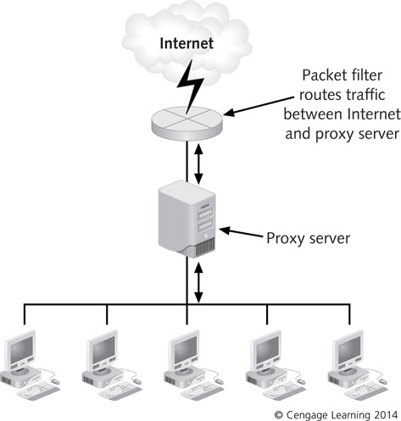
Figure 6 A packet filter connecting a proxy server with the Internet

Slide 24
Packet Filtering Based on Position
Packet filter placement (cont’d)
Place packet-filtering devices at either end of the DMZ
Filter on DMZ’s external interface needs to allow Internet users to gain access to servers on the DMZ but block access to the internal network
Filter on DMZ’s internal interface enables internal users to access servers on DMZ but not connect to Internet
Internal users connect to Internet through a proxy server on DMZ

Slide 25
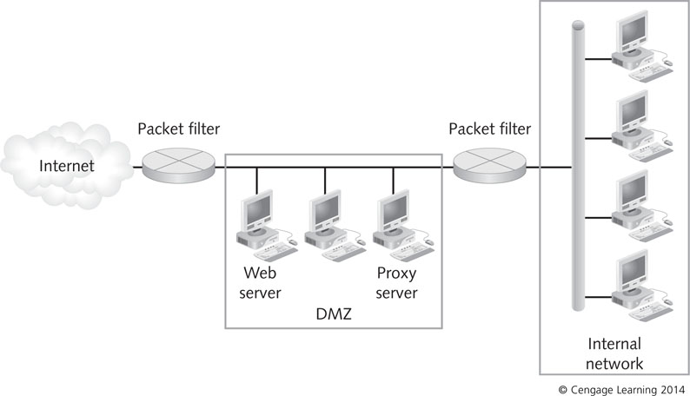
Figure 7 A packet filter routing traffic to and from a DMZ

Slide 26
Firewall Rule Sets
Rule base
Tells firewalls what to do when a certain kind of traffic attempts to pass
Effective firewall rule base should:
Be based on organization’s security policy
Include a firewall policy
Be simple and short as possible.
Restrict access to ports and subnets on the internal network from the Internet
Control Internet services

Slide 27
Base the Rule Base on Your Security Policy
When configuring rules pay attention to
Logging and auditing
Tracking
Filtering
Network Address Translation (NAT)
Quality of Service (QoS)
Desktop security policy
Rule base is a practical implementation of the organization’s policy

Slide 28
Base the Rule Base on Your Security Policy
Common guidelines that need to be reflected in the rule base:
Employees have access to Internet with restrictions
Public can access company’s Web and e-mail server
Only authenticated traffic can access the internal LAN
Employees are not allowed to use instant-messaging or social networking outside the internal network
Traffic from the company’s ISP should be allowed
Block external traffic by instant-messaging software
Only network administrator should be able to access internal network directly from the Internet

Slide 29
Create a Firewall Policy For Application Traffic
Firewall policy: addition to security policy that describes how firewalls should handle application traffic
Risk assessment provides a list of applications
And associated threats and vulnerabilities
General steps to create a firewall policy
Identify network applications that are needed
Determine methods for securing application traffic
Must balance security, user requirements, and cost
Consider all firewalls in your network
Develop a traffic matrix for each location

Slide 30
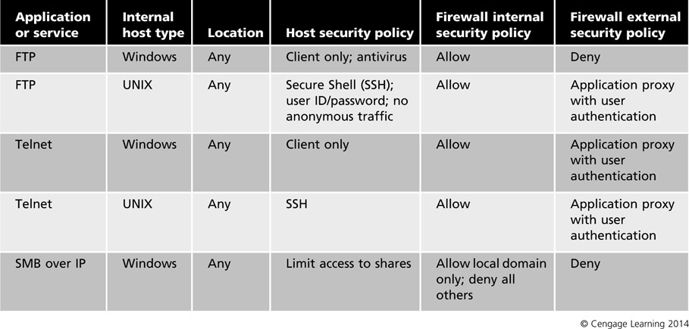
Table 4 Application traffic matrix

Slide 31
Create a Firewall Policy For Application Traffic
Firewalls enable you to control access to your computer or network
By controlling access to particular applications
Options for defining rules
Allow traffic
Block traffic
Ask or prompt – user is prompted when application attempts to access the Internet

Slide 32
Keep the Rule Base Simple
Keep list of rules as short as possible
About 30 rules (no more than 50 rules)
Shorter the rule base, faster the firewall will perform
Firewalls process rules in a particular order
Usually rules are numbered sequentially and displayed in a grid
Most important rules should be at the top of the list
Make the last rule a cleanup rule
Handles any other packets that have not been covered in preceding rules

Slide 33
Restrict Subnets, Ports, and Protocols
Filtering by IP addresses
You can identify traffic by IP address range
Most firewalls start blocking all traffic
You need to identify “trusted” networks
Firewall should allow traffic from trusted sources

Slide 34
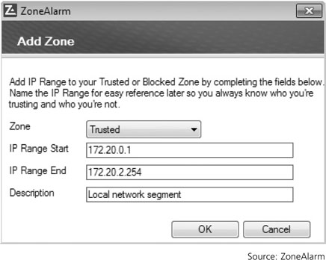
Figure 8 Identifying trusted subnets or IP addresses

Slide 35
Restrict Subnets, Ports, and Protocols
Filtering by ports
TCP and UDP break information into sections called segments(TCP) or datagrams (UDP)
Filters traffic based on TCP or UDP port numbers
Commonly called port filtering or protocol filtering
Can filter a wide variety of information
You can filter out everything but
TCP port 80 for Web traffic
TCP port 25 for e-mail traffic
TCP port 21 for FTP transmissions
Combination of an IP address and port number is called a socket

Slide 36
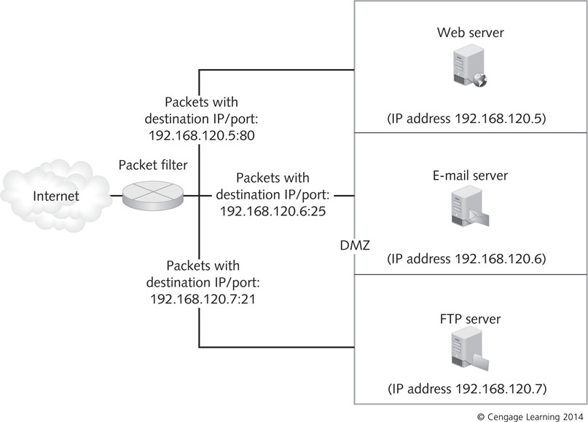
Figure 9 Port numbers direct packets to the client or server that needs them

Slide 37
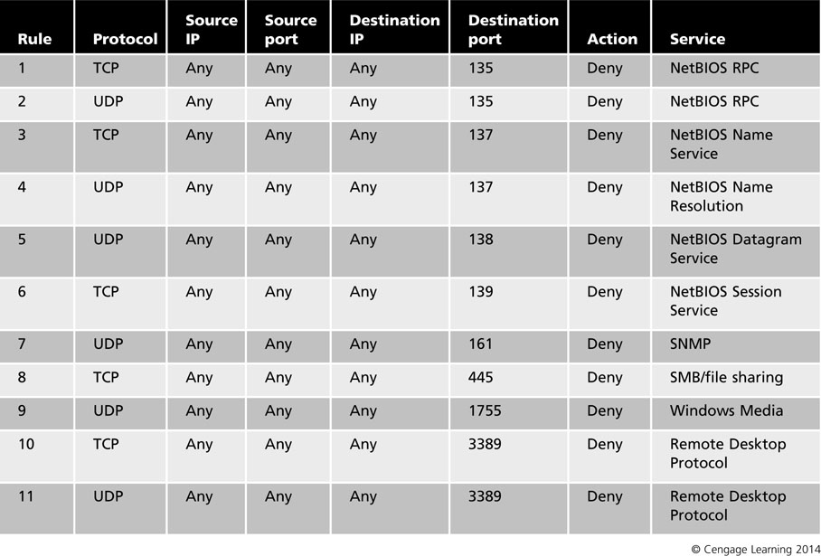
Table 5 Filtering Windows services and ports

Slide 38
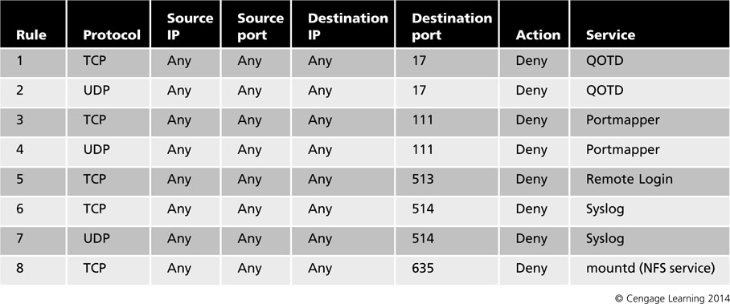
Restrict Subnets, Ports, and Protocols
UNIX has its own set of services that should be blocked when inbound from the Internet
Table 6 Filtering UNIX services and ports

Slide 39
Restrict Subnets, Ports, and Protocols
Filtering by service
Firewalls can filter by the name of a service
You do not have to specify a port number
Instead of filtering port 23, specify the Telnet service
Packets can be filtered based on ID field in the IP header
Firewalls can also filter by the six TCP control flags
Firewalls can also filter by the IP options
Security
Loose resource and record routing
Strict source and record routing
Internet timestamp

Slide 40
Restrict Subnets, Ports, and Protocols
Filtering by service (cont’d)
IPv6 contains many messages and responses
Such as Neighbor Discovery, Router Discovery, and Stateless Autoconfiguration
This information should be prevented from leaving the internal network but must pass through internal firewalls

Slide 41
Restrict Subnets, Ports, and Protocols
Filtering by service (cont’d)
Rules should follow a few general practices
Firewall with a “Deny All” security policy should begin by allowing services selectively as needed
Should keep everyone but administrator from connecting to the firewall
Should block direct access from the Internet to any computer behind the firewall
Should permit access to public servers in the DMZ and enable users to access the Internet

Slide 42
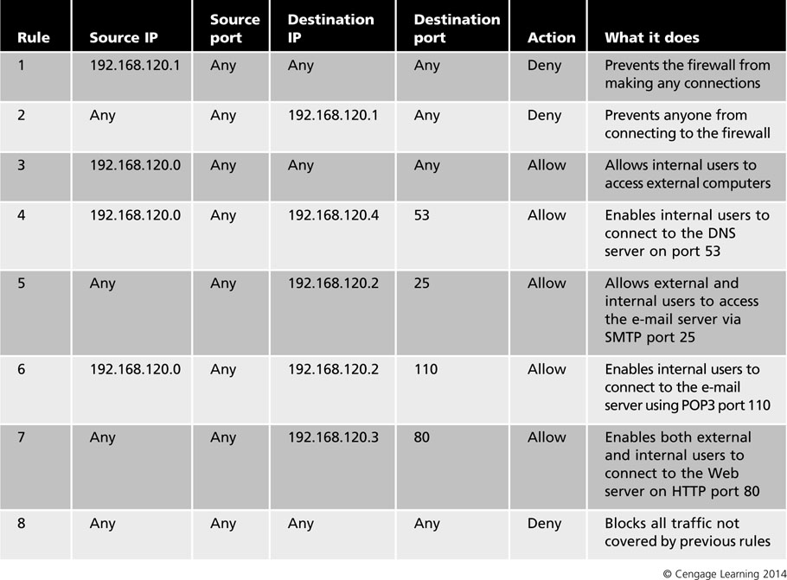
Table 7 A typical packet-filtering rule base

Slide 43
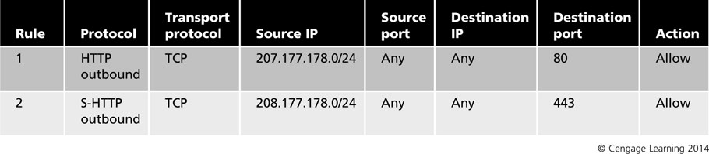
Control Internet Services
Web Services Rules
Employees need ability to use Internet and exchange e-mails
Table 8 Outbound Web access

Slide 44
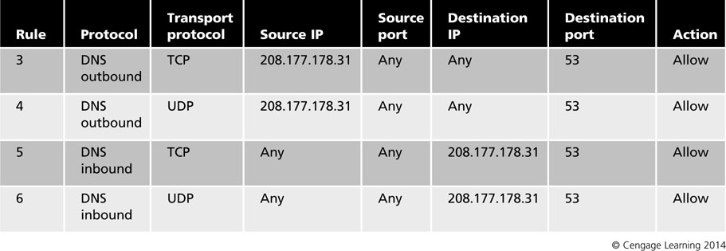
Control Internet Services
DNS Resolution
Resolves fully qualified domain names (FQDNs) to their corresponding IP addresses
DNS uses UDP port 53 for name resolution
DNS uses TCP port 53 for zone transfers
Table 9 DNS resolution rules

Slide 45
Control Internet Services
E-mail Configuration
Setting up firewall rules that permit filtering e-mail is not simple
Variety of e-mail protocol that can be used:
POP3 and IMAP4 for inbound mail transport
SMTP for outbound mail transport
Lightweight Directory Access Protocol (LDAP) for looking up email addresses
HTTP for Web-based email service
Secure Sockets Layer (SSL) encryption should be used for additional security

Slide 46
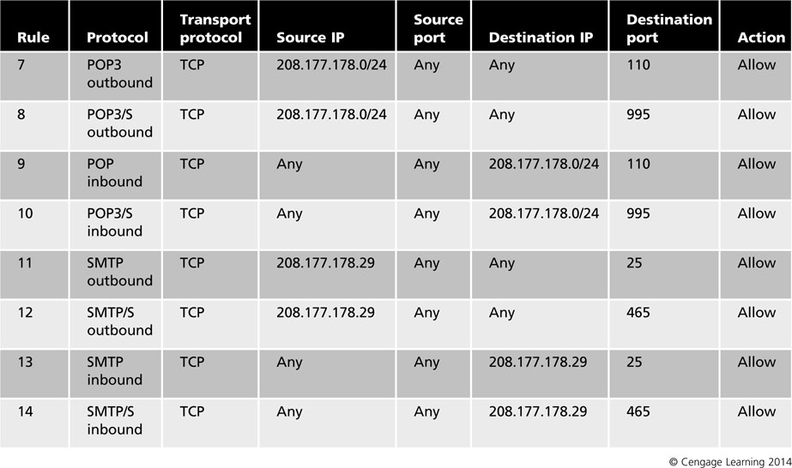
Table 10 E-mail rules

Slide 47
Control Internet Services
FTP Transactions
Types of FTP transactions
Active FTP
If supported by some clients in your network, you cannot specify a port because the client can establish a connection with the FTP server at any port above 1023
Instead, specify the IP address of your FTP server
Passive FTP

Slide 48
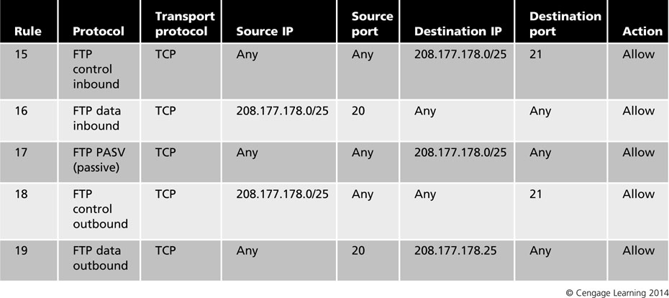
Table 11 FTP rules

Slide 49
Control Internet Services
ICMP Message Types
ICMPv4 and ICMPv6 function as housekeeping protocols for TCP/IP
Helps networks cope with communication problems
ICMPv4 packets have no authentication method
Attackers can use ICMP packets to attempt man-in-the-middle attacks
Firewall/packet filter must be able to determine whether an ICMP packet should be allowed to pass, based on message type

Slide 50
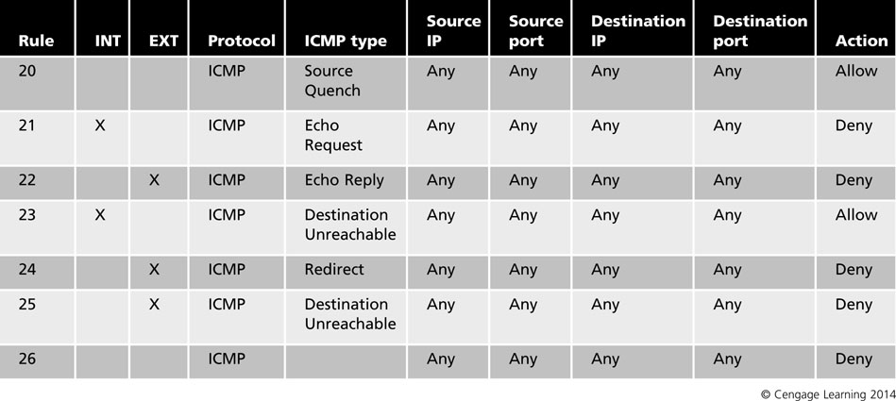
Table 12 Filtering ICMP message types

Slide 51
Control Internet Services
ICMP Message Types (cont’d)
ICMPv6 message types to pass through firewalls but never outside the organization:
Destination Unreachable (Type 1) – All codes
Packet Too Big (Type 2)
Time Exceeded (Type 3) – Code 0 only
Parameter Problem (Type 4) – Codes 1 and 2 only
Echo Request (Type 128)
Echo Response (Type 129)
Time Exceeded (Type 3) – Code 1
Parameter Problem (Type 4) – Code 0

Slide 52
Summary
Firewall is hardware or software that blocks unauthorized network access
Firewalls are not a standalone solution
Combine them with antivirus software, IDPSs, access control, and auditing
Software firewalls come as freeware, shareware, and commercial enterprise applications
Hardware firewall appliances are more expensive, but can handle more traffic
Stateless firewalls filter traffic based on protocol or IP address but are less secure than stateful firewalls

Slide 53
Summary
Stateful firewalls maintain state tables, which are records of connections that are considered trusted
Firewalls are effective only if they are configured correctly to block undesirable traffic and allow necessary traffic
Firewall rule base should be based on the organization’s security policy, provide rules for how applications can access the Internet, and be as simple and short as possible

Slide 54
References
J. Paul Guyer, P.E., R.A, "An Introduction to Intrusion Detection Systems", The Clubhouse Press, California, 2018.
Weaver, Randy, Dawn Weaver, and Dean Farwood. Guide to network defense and countermeasures. Cengage Learning, 2013.
G. Dileep Kumar, "Network Security Attacks and Countermeasures", IGI Global, 2016.
Nagendra Kumar Nainar, Yogesh Ramdoss, and Yoram Orzach, "Network Analysis Using Wireshark 2 Cookbook: Practical recipes to analyze and secure your network using Wireshark 2, 2nd Edition, Packt, 2018.
Andrei Miroshnikov, "Windows Security Monitoring: Scenarios and Patterns", Wiley, 2018.
Steve Suehring, "Linux Firewalls: Enhancing Security with nftables and Beyond", Addison-Wesley, 2015.
Easttom II, William Chuck. Network defense and countermeasures: principles and practices. Pearson IT Certification, 2013.
Snort 3.0 User manual, httpw://www.snort.org
Internet security http://www.cis.syr.edu/~wedu/Teaching/cis758/readings.html
Open Learn https://www.open.edu/openlearn/ocw/mod/oucontent/view.php?id=48261
IDPS https://cloudacademy.com/course/intrusion-detection-and-prevention-on-amazon-web-services/ids-ips-in-detail-1/
SVNIT course structure http://www.svnit.ac.in/web/department/computer/CO624.php
Detecting and Mitigating Cyber Threats and Attacks https://www.coursera.org/learn/detecting-cyber-attacks/home/welcome
Secure Networked System with Firewall and IDS https://www.coursera.org/learn/secure-networked-system-with-firewall-ids/home/welcome
https://www.coursera.org/learn/secure-networked-system-with-firewall-ids#syllabus
Customizable Network intrusion dataset creator https://github.com/nrajasin/Network-intrusion-dataset-creator
https://www.researchgate.net/post/Is_there_any_tool_to_convert_pcap_tcpdump_file_into_KDD_dataset_format
Information Security and Assurance https://people.eecs.ku.edu/~saiedian/710/
http://ranger.uta.edu/~dliu/courses/cse6392-ids-spring2007/
SNORT Tutorial https://www.youtube.com/watch?v=W1pb9DFCXLw&list=PLpPXZRVU-dX33VNUeqWrMmBNf5FeKVmi-

